Slide 1
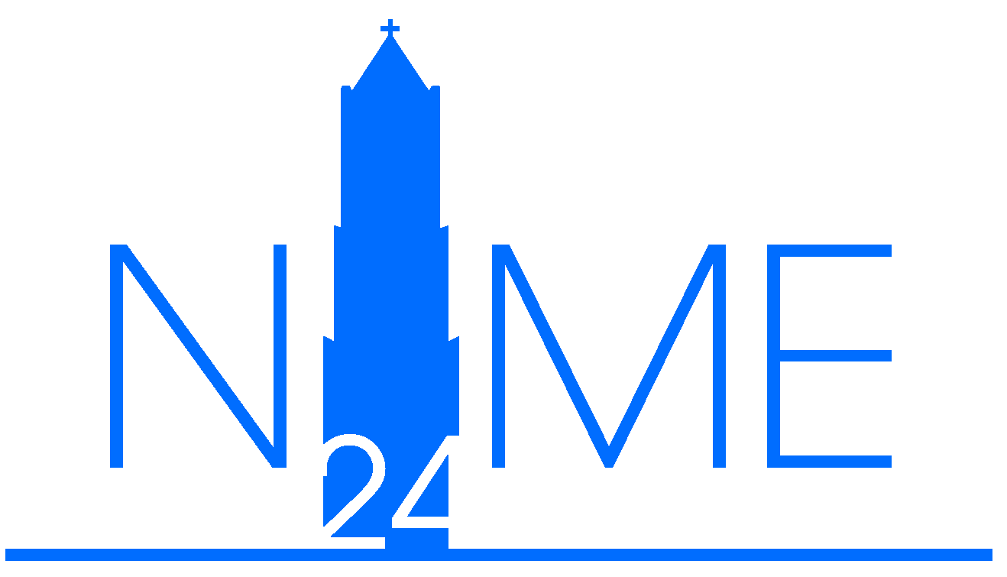
INTERFACING HUMAN NERVOUS SYSTEM AND COMPUTING TECHNOLOGY FOR MUSIC PERFORMANCE: Mapping Innovation of David Rosenboom (1970-2023)
Anastasia Chernysheva
????
UCLA, School of Music

Slide 2
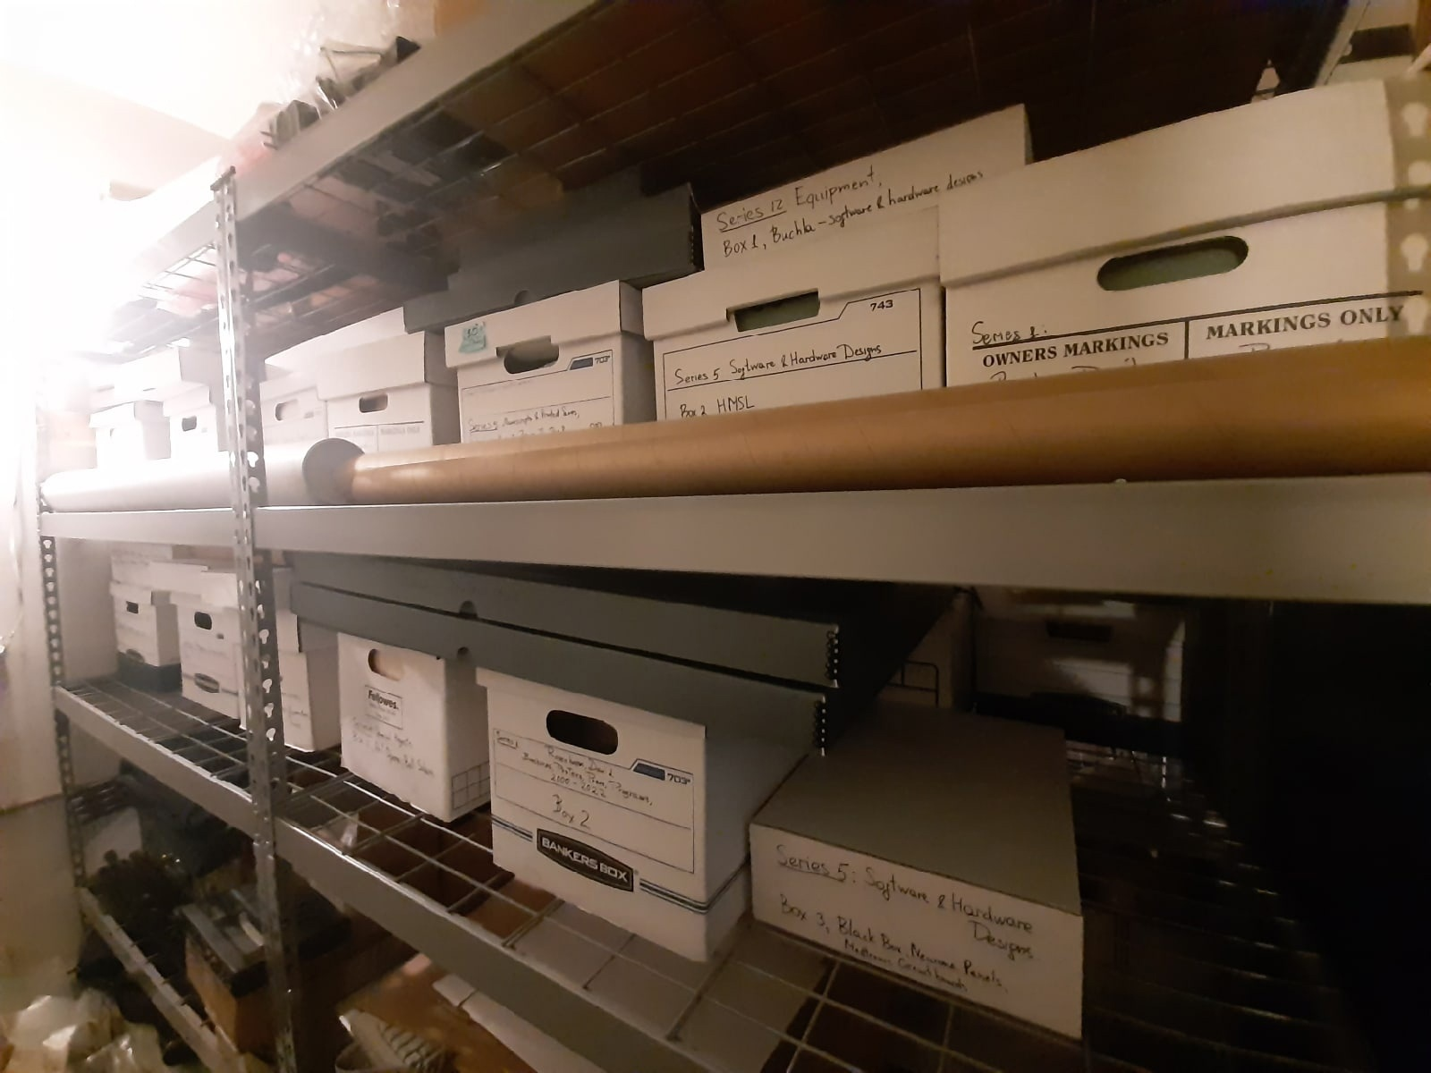
SUBJECT
The work of David Rosenboom
whose archive I put together (Finding Aid) and
whose performances and lectures dealing
with neuromusic I produced in 2022.
In collaboration with Rosenboom, I planned
working on an installation,
developing a comprehensive course of theory and practice of biofeedback music,
issuing a new edition of the ‘75 book “Biofeedback and the Arts.”
The plan had to be modified while I stay committed to the main frame.
Chernysheva, A. NIME 2024

Slide 3
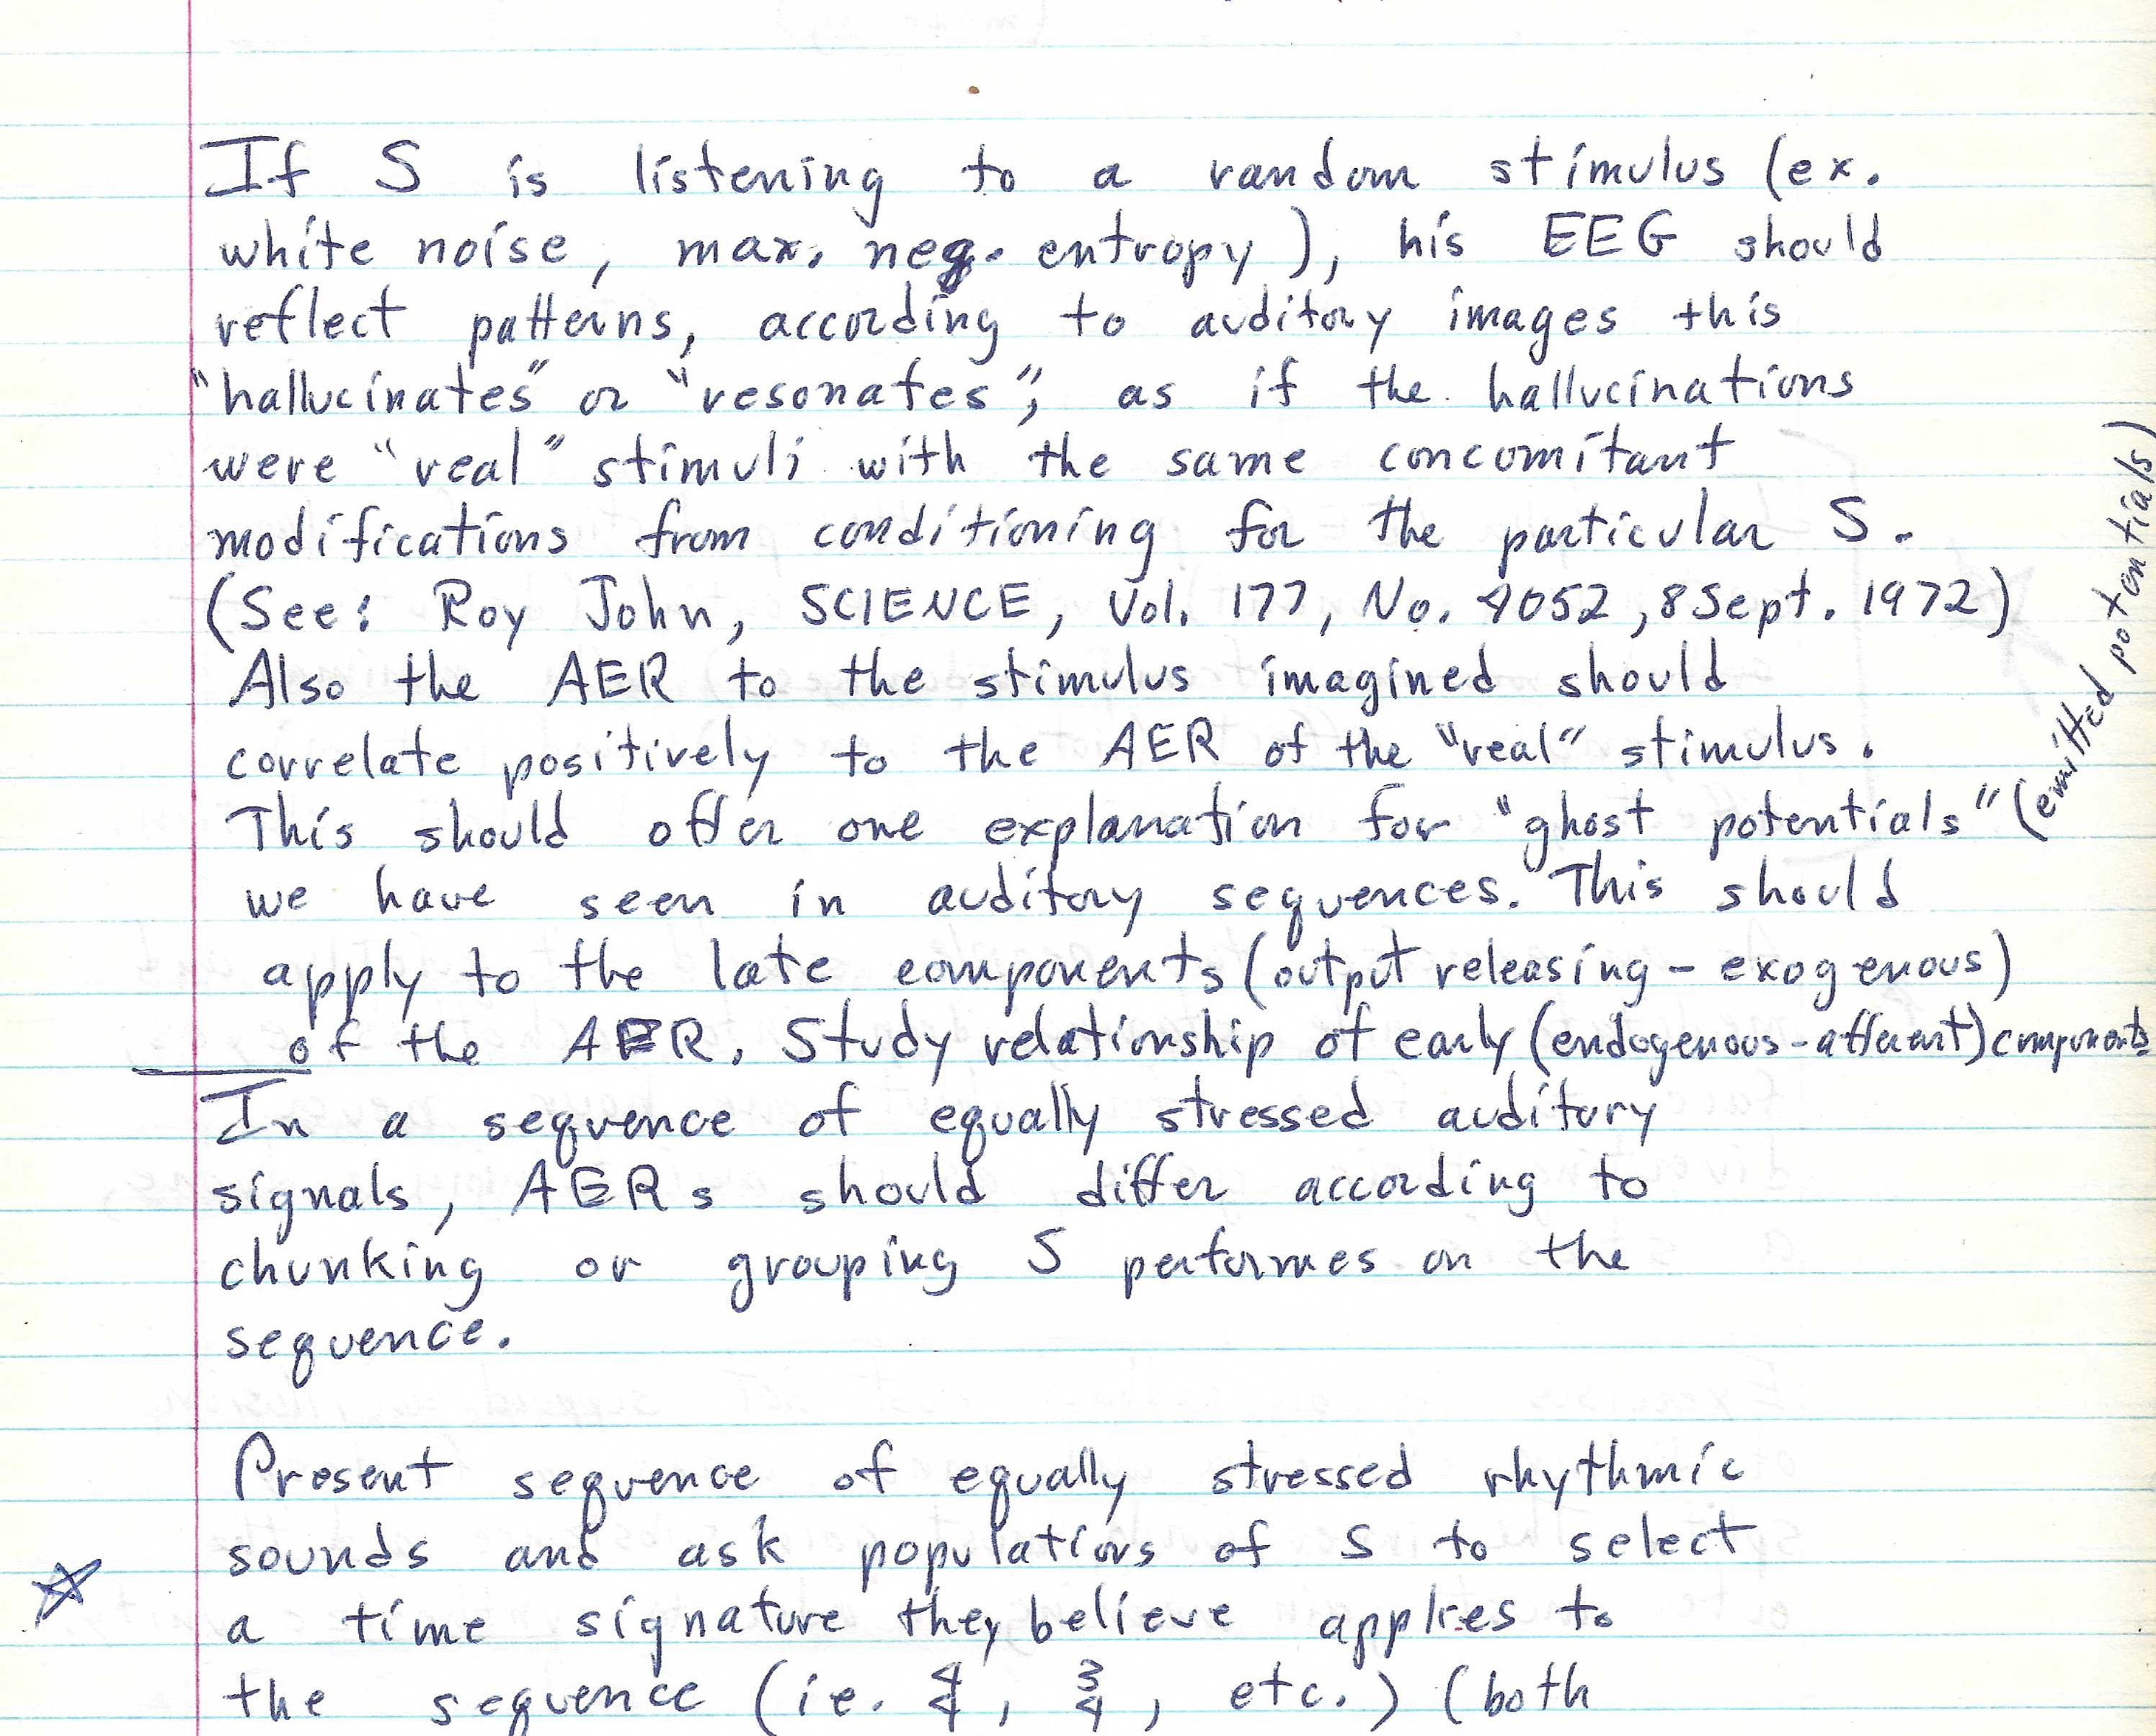
THEORETICAL BACKGROUND/ BIBLIOGRAPHY (selected) OK?
Cateforis, D., Duval, S., & Steiner, S. (Eds.). (2018). Hybrid Practices: Art in Collaboration with Science and Technology in the Long 1960s. University of California Press.
Gardner, P., & Wray, B. (2013). From lab to living room: Transhumanist imaginaries of consumer brain wave monitors. Ada: A Journal of Gender, New Media, and Technology, No.3.
Gee, E. (2023). The BioSynth—an affective biofeedback device grounded in feminist thought. In Proceedings of the International Conference on New Interfaces for Musical Expression.
Iverson, J. (2018). Electronic Inspirations: Technologies of the Cold War Musical Avant-Garde. Oxford University Press.
Kaiser, D., & McCray, W. P. (Eds.). (2016). Groovy science: Knowledge, innovation, and American counterculture. University of Chicago Press.
Lysen, F. (2022). Brainmedia: One Hundred Years of Performing Live Brains, 1920–2020. Bloomsbury Publishing USA.
Nijholt, A. (2019). Introduction: brain-computer interfaces for artistic expression. Brain Art: Brain-Computer Interfaces for Artistic Expression, 1-29.
Novello, A. (2012). From invisible to visible: the EEG as a tool for music creation and control. Based on my Master’s Thesis for the Institute of Sonology, Den Haag.
Ortiz, M., Grierson, M., & Tanaka, A. (2014). Brain Musics: History, Precedents, and Commentary on Whalley, Mavros, and Furniss. Empirical Musicology Review, 9(3-4), 277-281.
Peper, E., & Shaffer, F. (2018). Biofeedback history: An alternative view. Biofeedback, 46(4), 80-85.
Reichardt, J. (Eds.). (1971). Cybernetics, art, and ideas (p. 57f). London: Studio Vista.
Rosenboom, D. (Ed.) (1975) Biofeedback and the Arts: Results of Early Experiments. Aesthetic Research Centre of Canada Publications, Vancouver.
Rosenboom, D. (1970). In support of a systems theoretical approach to art media. Proceedings of the Fifth Annual Conference of the American Society of University Composers, Inc., 56-68.
Vidal, J. J. (1973). Toward direct brain-computer communication. Annual review of Biophysics and Bioengineering, 2(1), 157-180.
Chernysheva, A. NIME 2024

Slide 4
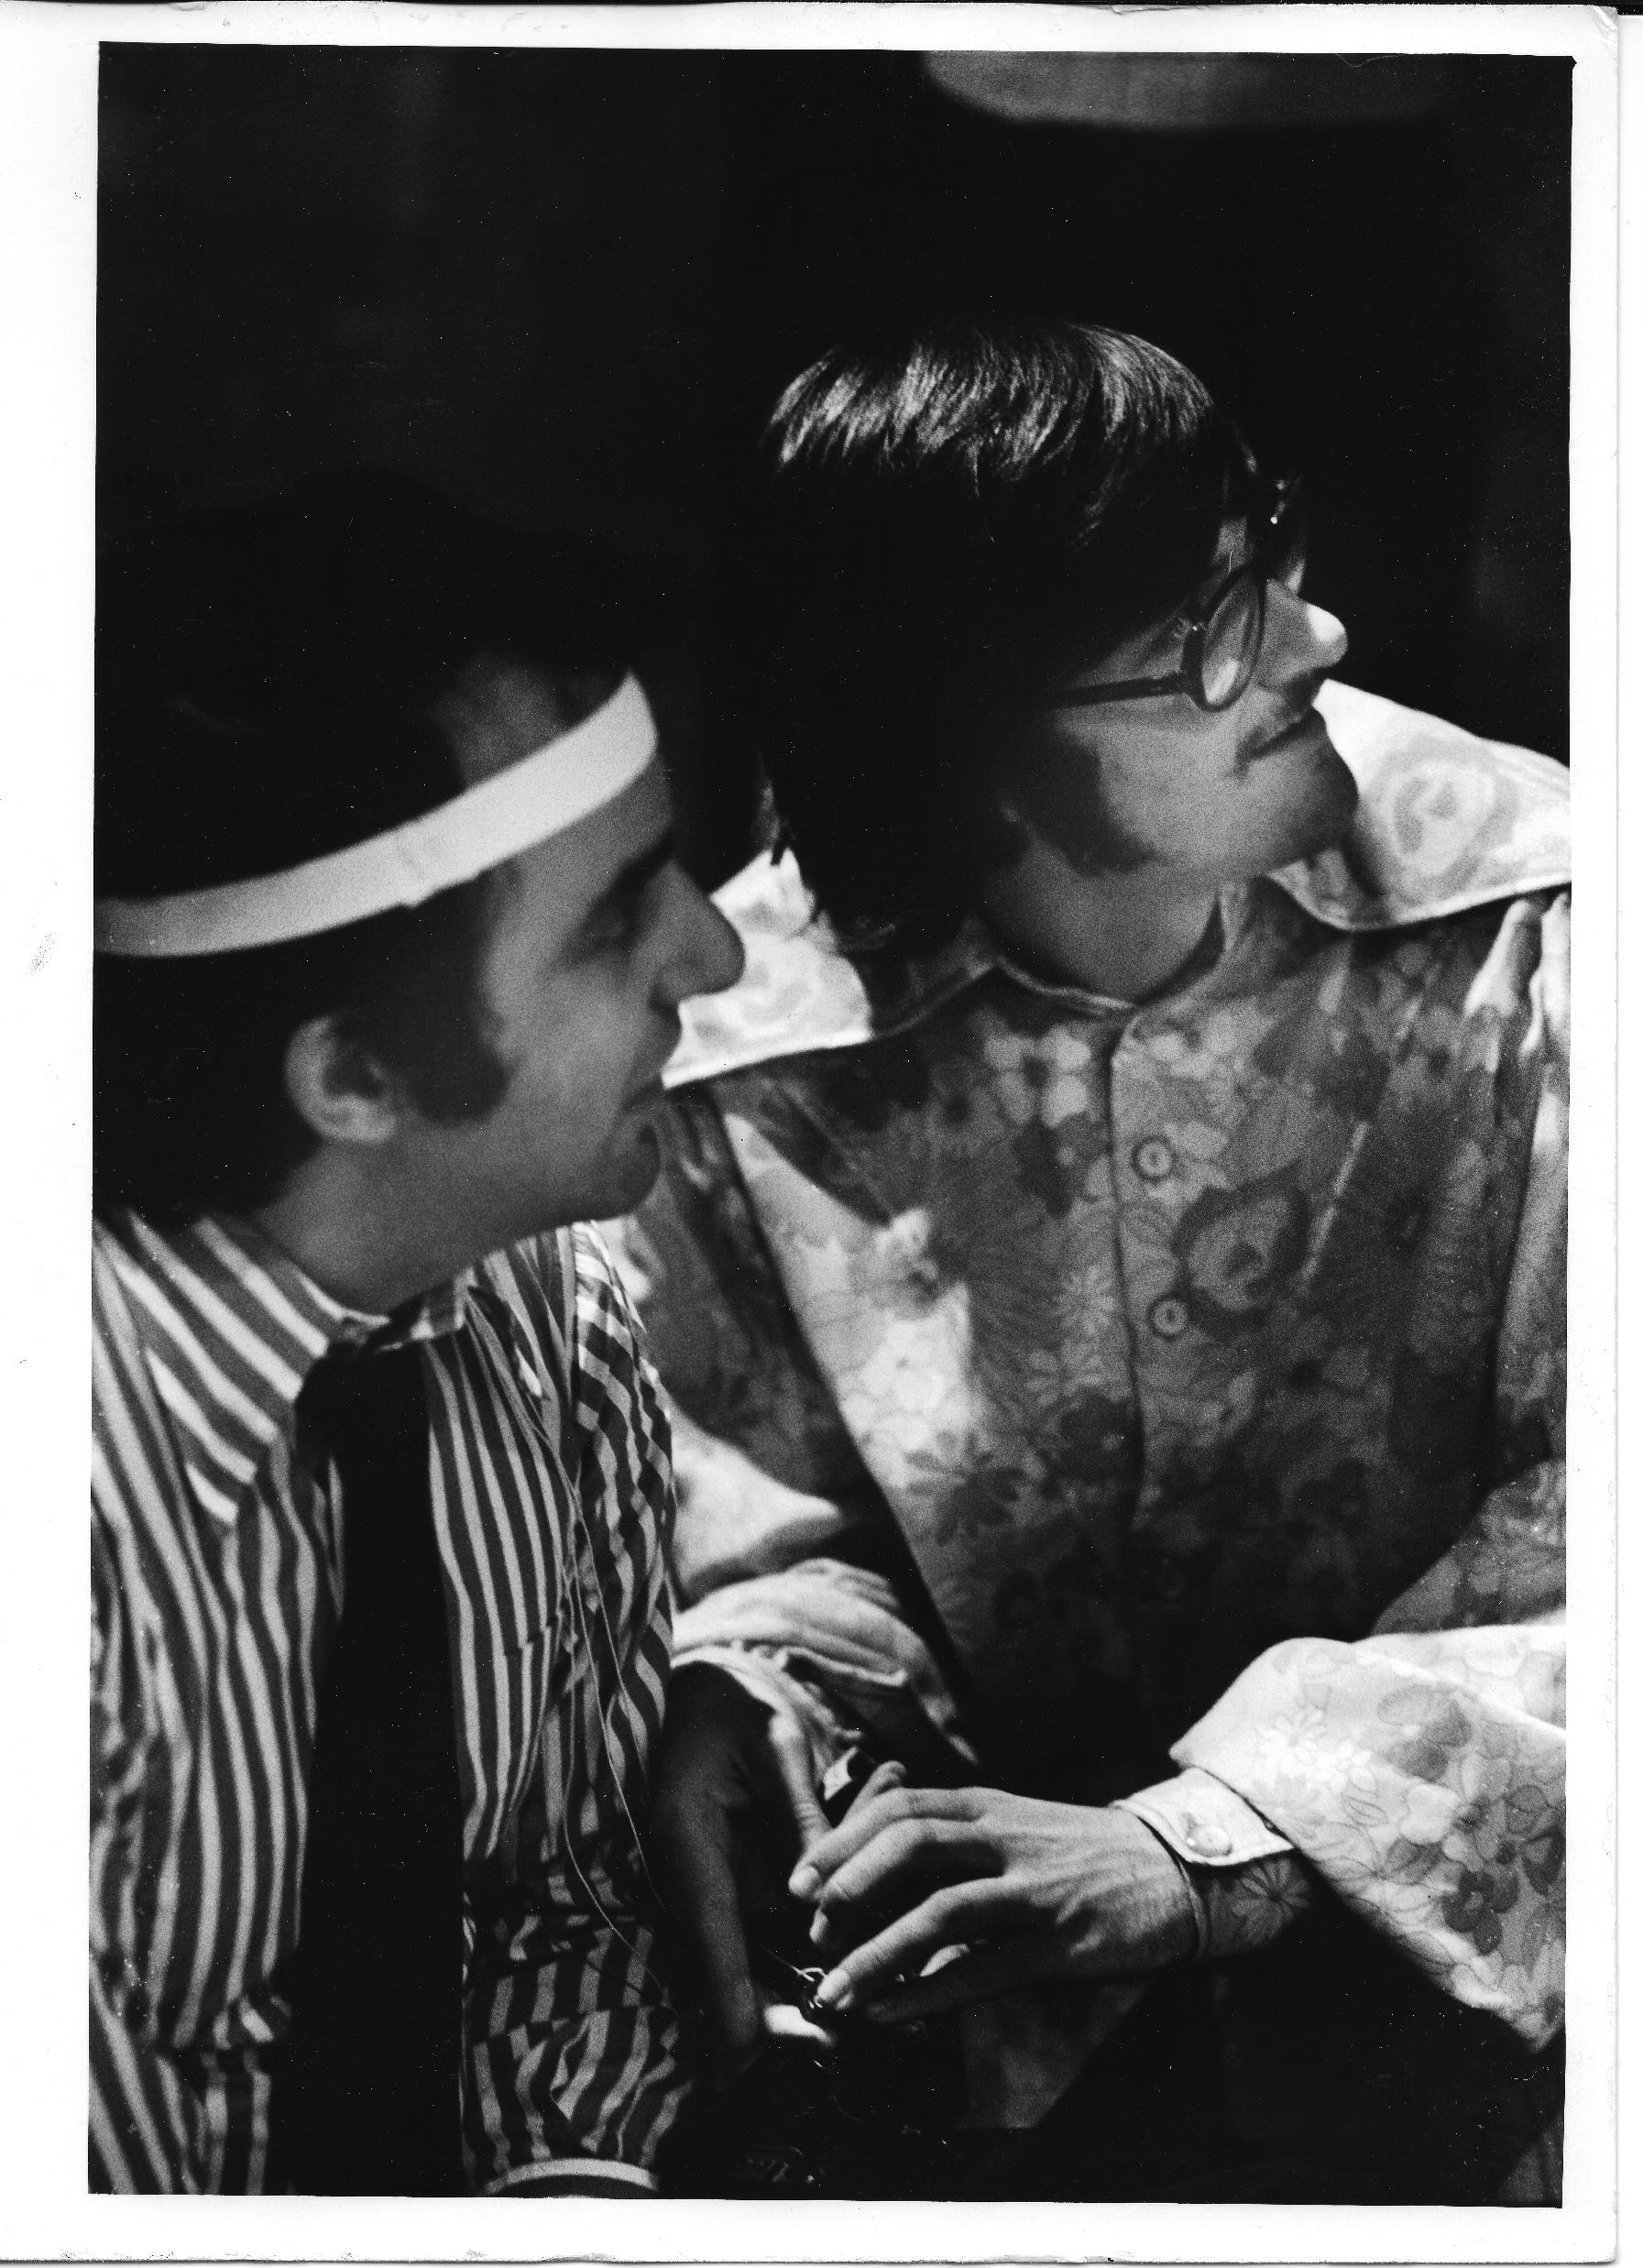
RESEARCH QUESTIONS
How the work of Rosenboom qualitatively differs from biofeedback music of Alvin Lucier and Richard Teitelbaum?
What factors made the innovation of Rosenboom possible? Who facilitated his biofeedback music practice?
What practitioners may learn from the analysis of the biofeedback music of Rosenboom?
Chernysheva, A. NIME 2024

Slide 5
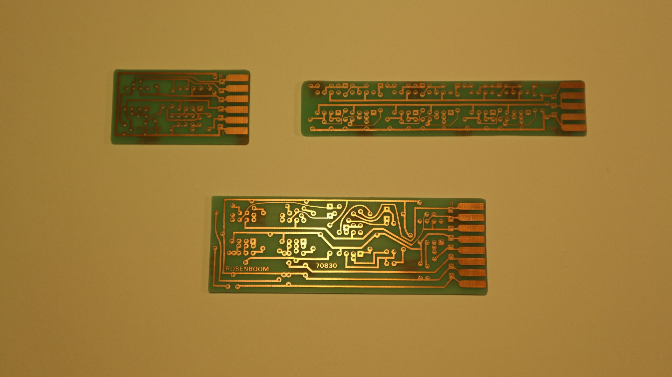
METODOLOGY
Interview (qualitative)
Close reading and analysis of archival materials
Comparative analysis
Chernysheva, A. NIME 2024

Slide 6
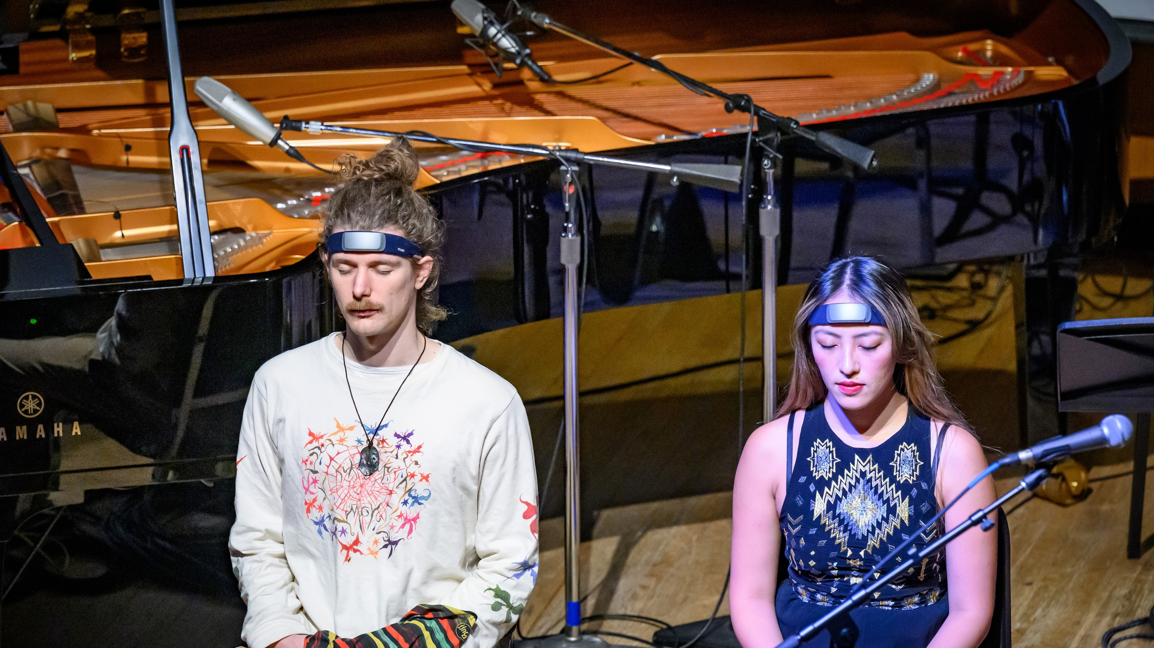
QUESTIONS FOR THE CONSORTIUM
How practitioners may benefit from knowing about Rosenboom’s practice? Do you find the critique of the canon useful?
What other problems with the canon do you see?
What do you see as reasons for biofeedback music not becoming mainstream/a part of music education? As this happened with electronic music.
?????
Chernysheva, A. NIME 2024

